Slide 1
Review Questions

Slide 2
3) The relational data model consists of which components?
A) Data structure
B) Data manipulation
C) Data integrity
D) All of the above
Notes:
Answer: D
Diff: 1 Page Ref:156
Topic: The Relational Data Model
AACSB: Use of Information Technology

Slide 3
4) A two-dimensional table of data is called a:
A) group.
B) set.
C) declaration.
D) relation.
Notes:
Answer: D
Diff: 1 Page Ref:157
Topic: The Relational Data Model
AACSB: Analytic Skills, Use of Information Technology
Subtopic: Relational Data Structure

Slide 4
8) A primary key that consists of more than one attribute is called a:
A) foreign key.
B) composite key.
C) multivalued key.
D) cardinal key.
Notes:
Answer: B
Diff: 2 Page Ref:157
Topic: The Relational Data Model
AACSB: Use of Information Technology
Subtopic: Relational Keys

Slide 5
14) The ________ states that no primary key attribute may be null.
A) referential integrity constraint
B) entity integrity rule
C) partial specialization rule
D) range domain rule
Notes:
Answer: B
Diff: 2 Page Ref:161
Topic: The Relational Data Model
AACSB: Analytic Skills, Reflective Thinking
Subtopic: Entity Integrity

Slide 6
17) Which of the following are anomalies that can be caused by redundancies in tables?
A) Insertion
B) Deletion
C) Modification
D) All of the above
Notes:
Answer: D
Diff: 1 Page Ref:164, 165
Topic: Integrity Constraints
AACSB: Analytic Skills, Use of Information Technology
Subtopic: Well-Structured Relations

Slide 7
True of False
59) A cascading delete removes all records in other tables associated with the record to be deleted.
Notes:
Answer: TRUE
Diff: 2 Page Ref:162
Topic: Integrity Constraints
AACSB: Use of Information Technology
Subtopic: Referential Integrity

Slide 8
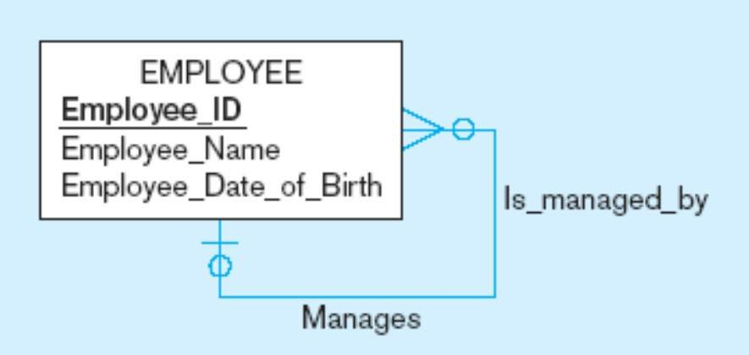
True or False
70) In the figure below, each employee has exactly one manager.
Notes:
Answer: FALSE… An employee may have NO manager
Diff: 2 Page Ref:173.174
Topic: Transforming EER Diagrams into Relations
AACSB: Analytic Skills, Use of Information Technology
Subtopic: Step 5: Map Unary Relationships

Slide 9
18) The subtype discriminator is a composite attribute when there is a(n):
A) overlap rule.
B) disjoint rule.
C) partial specialization.
D) full specialization.
Notes:
Answer: A
Diff: 2 Page Ref:125
Topic: Specifying Constraints in Supertype/Subtype Relationships
AACSB: Analytic Skills, Use of Information Technology
Subtopic: Defining Subtype/Supertype Hierarchies

Slide 10
20) In a supertype/subtype hierarchy, subtypes that are lower in the hierarchy inherit attributes from not only their immediate supertype but from all ________ in the hierarchy.
A) subtypes
B) supertypes
C) constraints
D) dimensions
Notes:
Answer: B
Diff: 2 Page Ref:127
Topic: Supertype/Subtype Hierarchies
AACSB: Reflective Thinking
Subtopic: Summary of Supertype/Subtype Hierarchies

Slide 11
True or False
36) A completeness constraint may specify that each entity of the supertype must be a member of some subtype in the relationship.
Notes:
Answer: TRUE
Diff: 1 Page Ref:121
Topic: Specifying Constraints in Supertype/Subtype Relationships
AACSB: Use of Information Technology
Subtopic: Specifying Completeness Constraints

Slide 12
10) In which data model would a code table appear?
A) Conceptual
B) Logical
C) Physical
D) Data layout
Notes:
Answer: C
Diff: 2 Page Ref:213
Topic: Designing Fields
AACSB: Use of Information Technology
Subtopic: Coding Techniques

Slide 13
16) Distributing the rows of data into separate files is called:
A) normalization.
B) horizontal partitioning.
C) vertical partitioning.
D) file allocation.
Notes:
Answer: B
Diff: 1 Page Ref:218
Topic: Denormalizing and Partitioning Data
AACSB: Analytic Skills, Use of Information Technology
Subtopic: Partitioning

Slide 14
37) A rule of thumb for choosing indexes is to:
A) be careful indexing attributes that may be null.
B) index each primary key of each table.
C) use an index when there is variety in attribute values.
D) all of the above.
Notes:
Answer: D
Diff: 1 Page Ref:230
Topic: Using and Selecting Indexes
AACSB: Analytic Skills, Use of Information Technology

